Slide 1


JSPM’s
Rajarshi Shahu College of Engineering, Tathawade, Pune
(An Autonomous Institute affiliated to Savitribai Phule Pune University)
Department of Computer Science and Business Systems
Academic Year: 2026-27
Project Title:
“ LIBRARY MANAGEMENT SYSTEM “
Students Name and PRN no: Premraj Gopichand Goykar (RBT25CB036)
Harshadeep Praful Thul (RBT25CB022)
Date: 22-10-2026
Course Name: Database Management System
Course Coordinator: Prof. Rutuja S. Bachhav

Slide 2
Index
Introduction
Problem Definition & Objectives
Literature Survey
Feasibility Study
System Design & Architecture
Database Design & ER Diagram
SQL Implementation & Results
Conclusion
References

Slide 3
Introduction
Library Management System
A secure two-tier web application for daily library work. The librarian signs in, and a Flask back end applies the library rules and stores books, members, issues, renewals and fines in MySQL.
Key Functions
Login with roles (admin / librarian)
Issue, return and renew books; automatic fines
Search, edit, reports, CSV export, activity log
Backups, Docker deployment, automated tests
Technology: HTML/CSS/JS | Flask (Python) | MySQL | Docker | GitHub

Slide 4
Problem Definition & Objectives
Problem Definition
Manual library records are slow, error-prone and insecure. Fines are calculated by hand, stock is not checked, nobody knows who changed a record, and there is no backup.
Objectives
Centralize records in a MySQL database
Automate due dates, renewals and fines
Enforce rules with constraints and transactions
Secure access: login, roles, activity log
Make it reliable for daily use: backups, tests, Docker
Goal: A dependable, database-driven library system ready for GitHub.

Slide 5
Literature Survey
Existing System
Traditional library management relies on:
Manual registers
Spreadsheets
Costly commercial software
Limitations
Slow searching and manual fines
No check for available copies
No security, no history of changes
No backup; risk of data loss
Proposed Approach
A relational database + secured web application built on free, open-source tools.

Slide 6
Feasibility Study
Technical
MySQL 8 + Workbench, Python Flask, HTML/CSS/JS
Runs on a basic computer; Docker optional
Economic
All tools are open-source and free
No specialized hardware
Operational
Simple web interface for the librarian
Backup command and health check for daily use
Conclusion: ✔ Technically, economically & operationally feasible.

Slide 7
System Design & Architecture
System Flow (2-Tier Application)
Librarian (Web Browser)
↓ HTML + CSS + JavaScript, login + CSRF token
Flask REST API – validation, rules, audit log
↓ JSON over HTTP, SQL via PyMySQL (transactions)
MySQL Database – LibraryDB
↓
Member | Book | Issue | Fine | Librarian | Audit_Log
Core Modules
Dashboard / Reports → totals, overdue, activity log
Books / Members → add, search, edit, delete
Issue / Return / Renew → transaction + due date + fine
Fines → view and mark paid

Slide 8
Reliability, Security & Deployment
Reliability
Issue / return / renew run as one transaction (rollback on error)
Atomic stock update: Quantity - 1 WHERE Quantity > 0
Error handling, rotating log file, /health check
python manage.py backup (dated, keeps last 14)
Security
Login with PBKDF2-hashed passwords; admin / librarian roles
CSRF token, login lock-out, parameterised SQL
Activity (audit) log of every action
Deployment
Docker Compose (MySQL + app), GitHub Actions runs tests

Slide 9
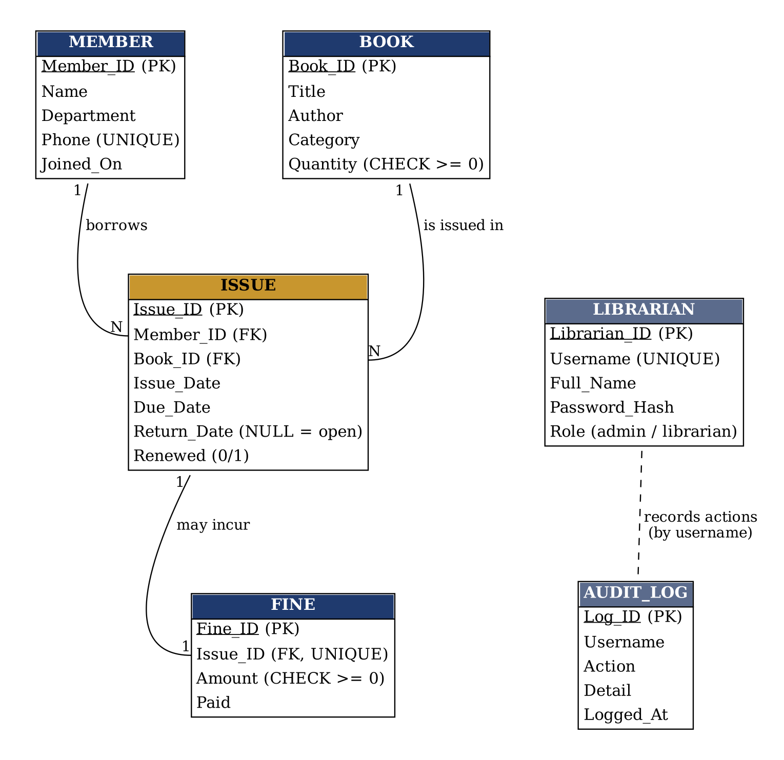
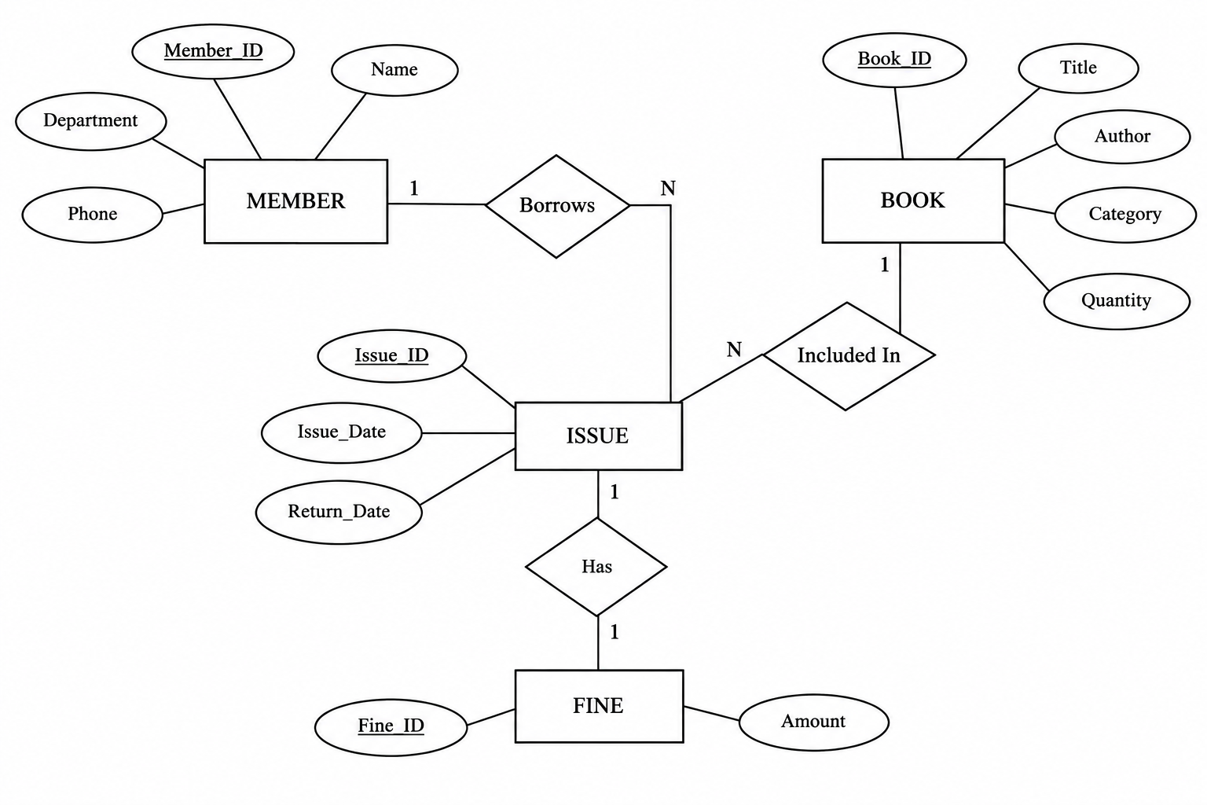
Database Design & ER Diagram
Database Structure
Table | Purpose
Member / Book | People and stock
Issue / Fine | Loans, renewals, fines
Librarian | Staff login, roles
Audit_Log | History of actions
Key Relationships
Member → Issue ← Book ; Issue → Fine

Slide 10
SQL Implementation
SQL Operations
CREATE → tables, constraints, view, index
INSERT → sample data, audit log
SELECT / WHERE → search & filter
JOIN → Issue + Member + Book + Fine
GROUP BY / SUM → reports
UPDATE in a TRANSACTION → stock, returns
PROCEDURE / TRIGGER → history, stock guard
Implementation Result
✔ 6 related tables with PK, FK, CHECK
✔ Flask API connected to MySQL
✔ Issue / return / renew are transactions
✔ 27 automated tests passed
-- Issue a book (one transaction)
INSERT INTO Issue(Member_ID,Book_ID,
Issue_Date,Due_Date)
VALUES(%s,%s,%s,%s);
UPDATE Book
SET Quantity = Quantity - 1
WHERE Book_ID = %s
AND Quantity > 0; -- atomic
-- Fine on late return
INSERT INTO Fine(Issue_ID,Amount)
VALUES(%s, days_late * 2);

Slide 11
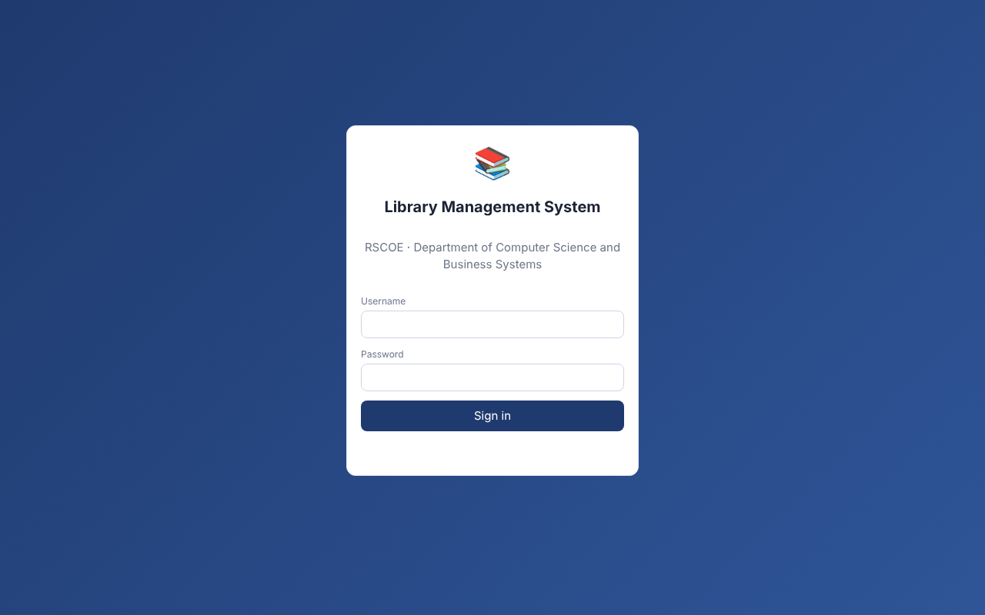
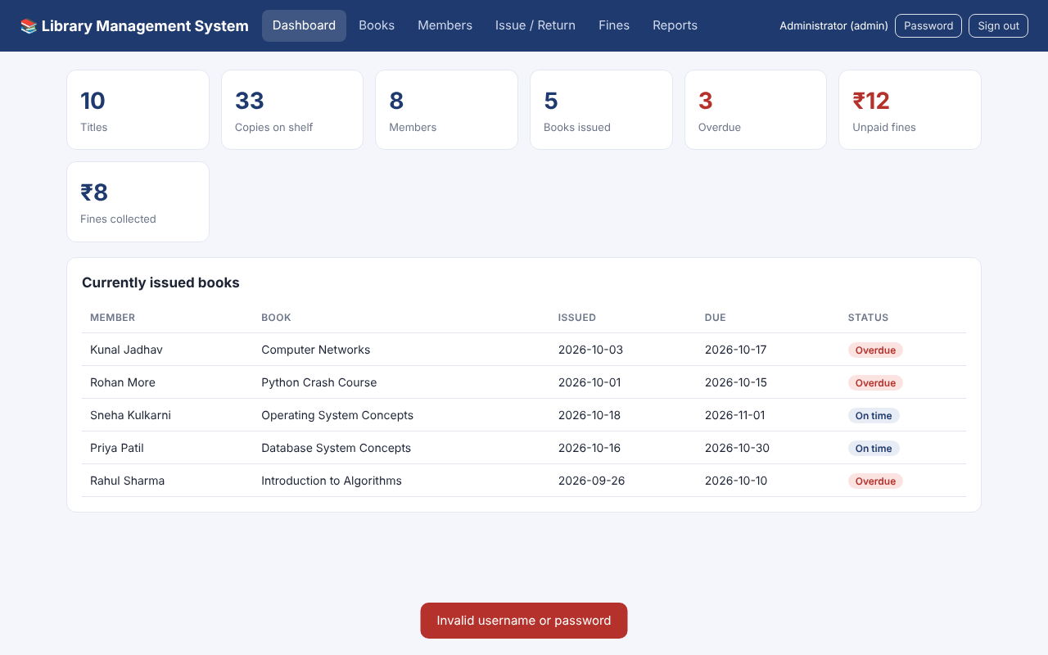
Results – Login & Dashboard
Login page
Dashboard

Slide 12
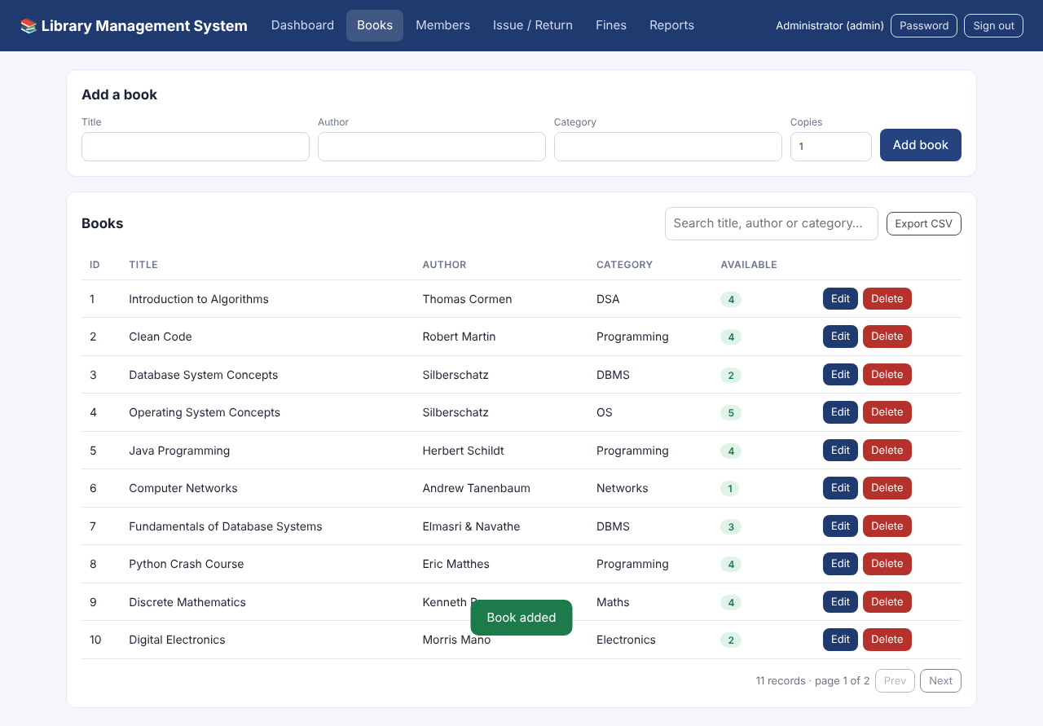
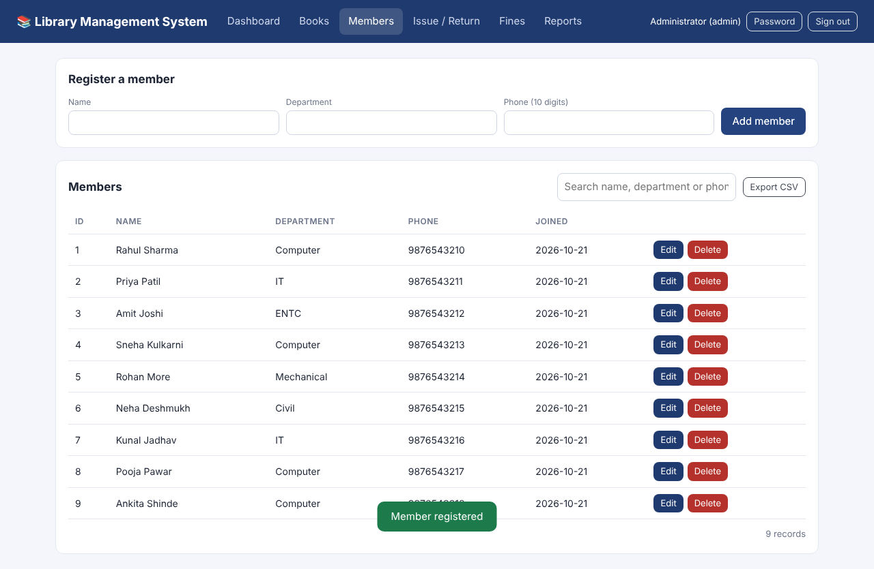
Results – Books & Members
Add / list books
Members

Slide 13
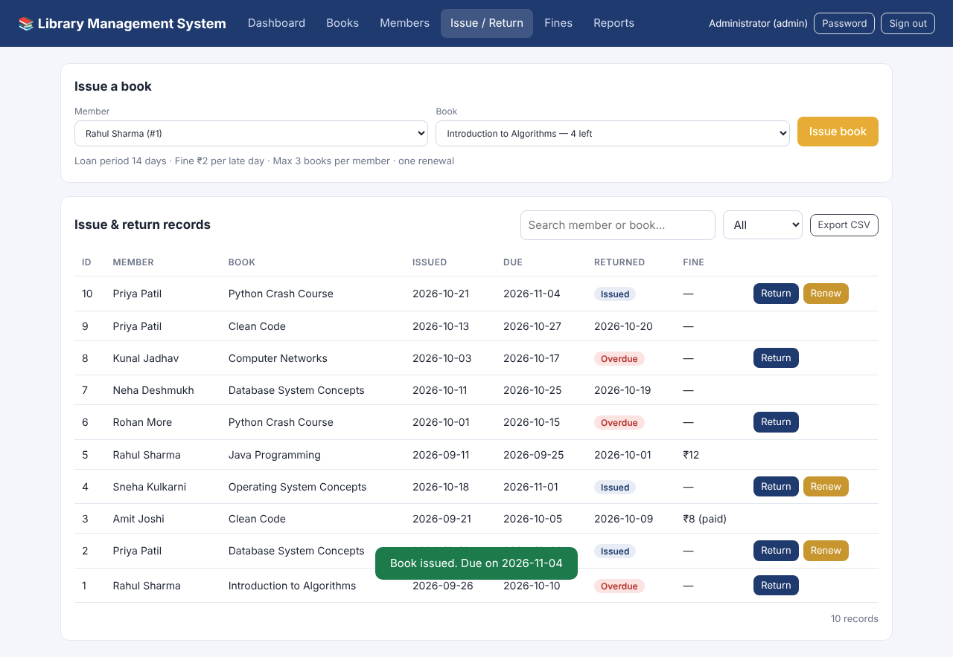
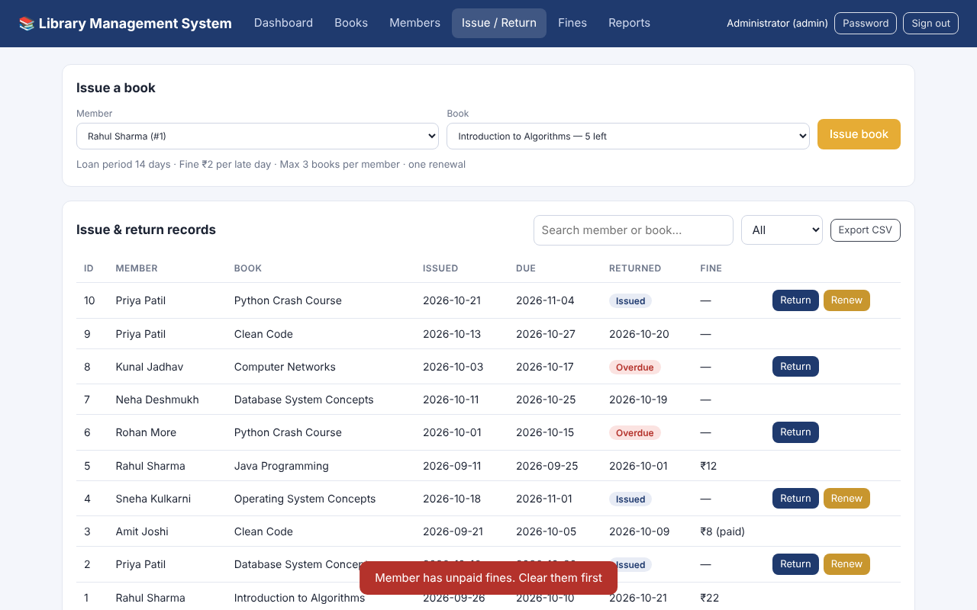
Results – Issue & Return
Blocked: unpaid fine
Book issued, due date set

Slide 14
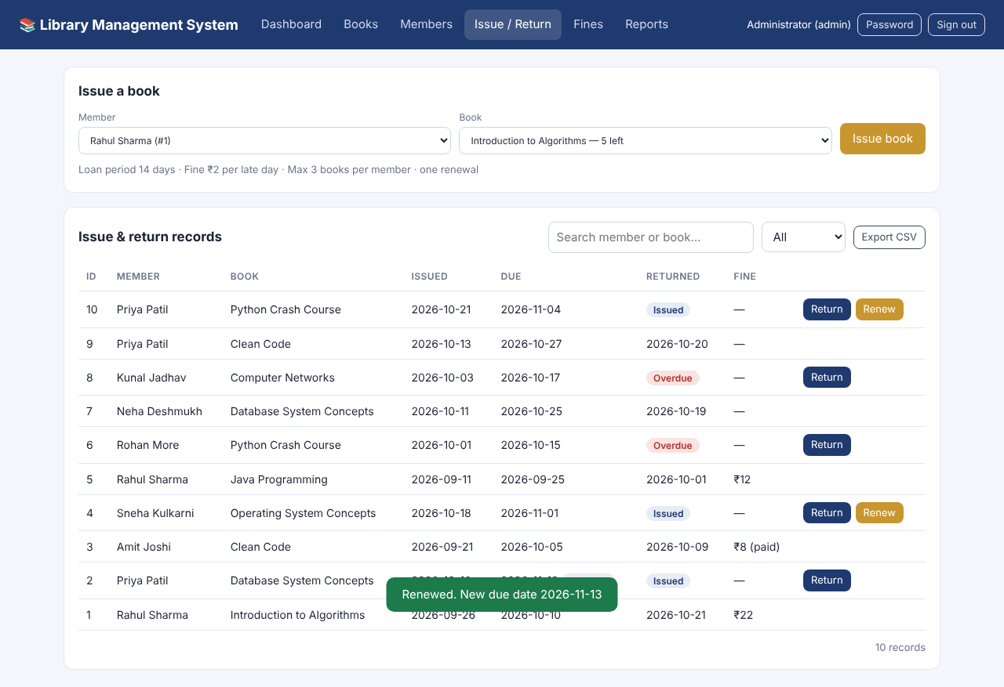
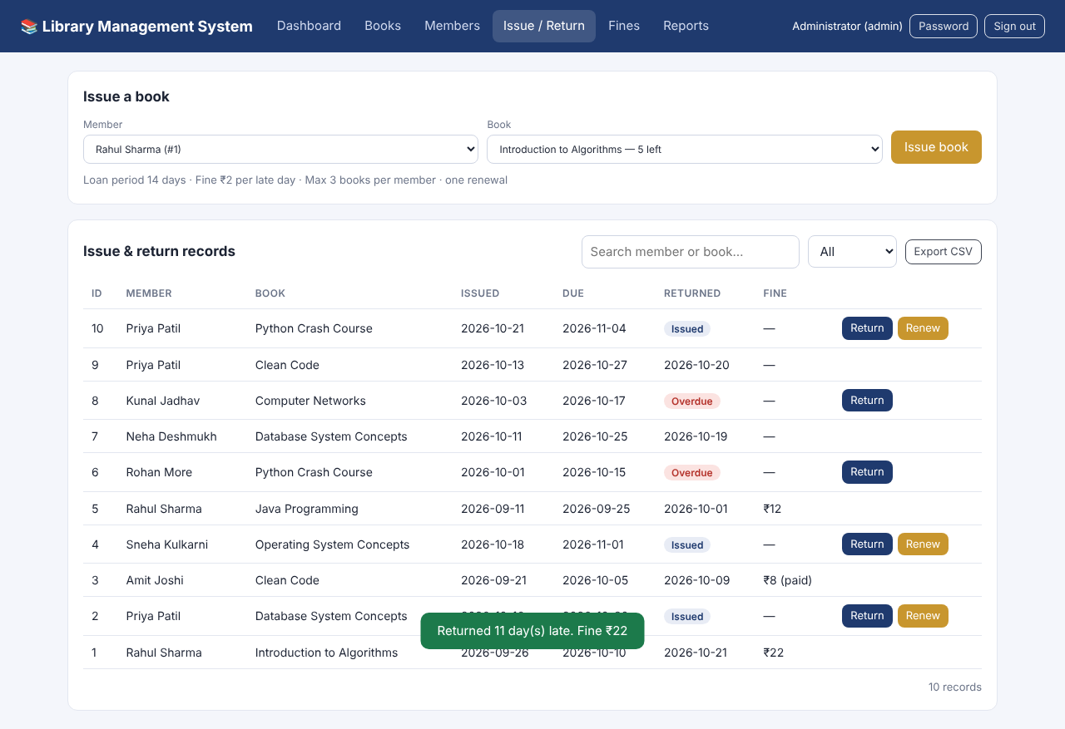
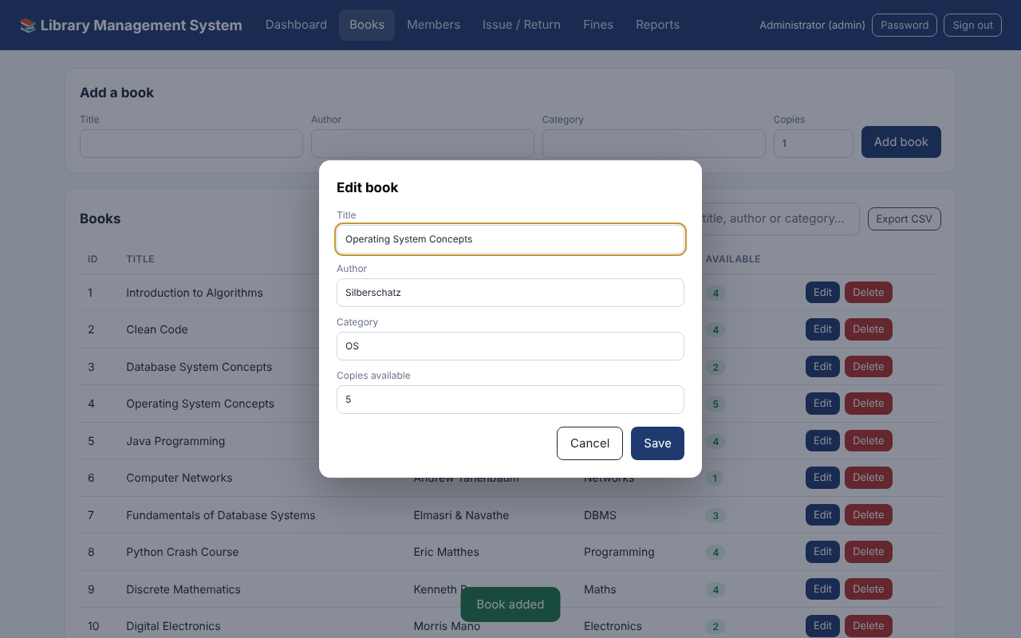
Results – Renew, Fine & Edit
Renewed
Late return: ₹22 fine
Edit dialog

Slide 15
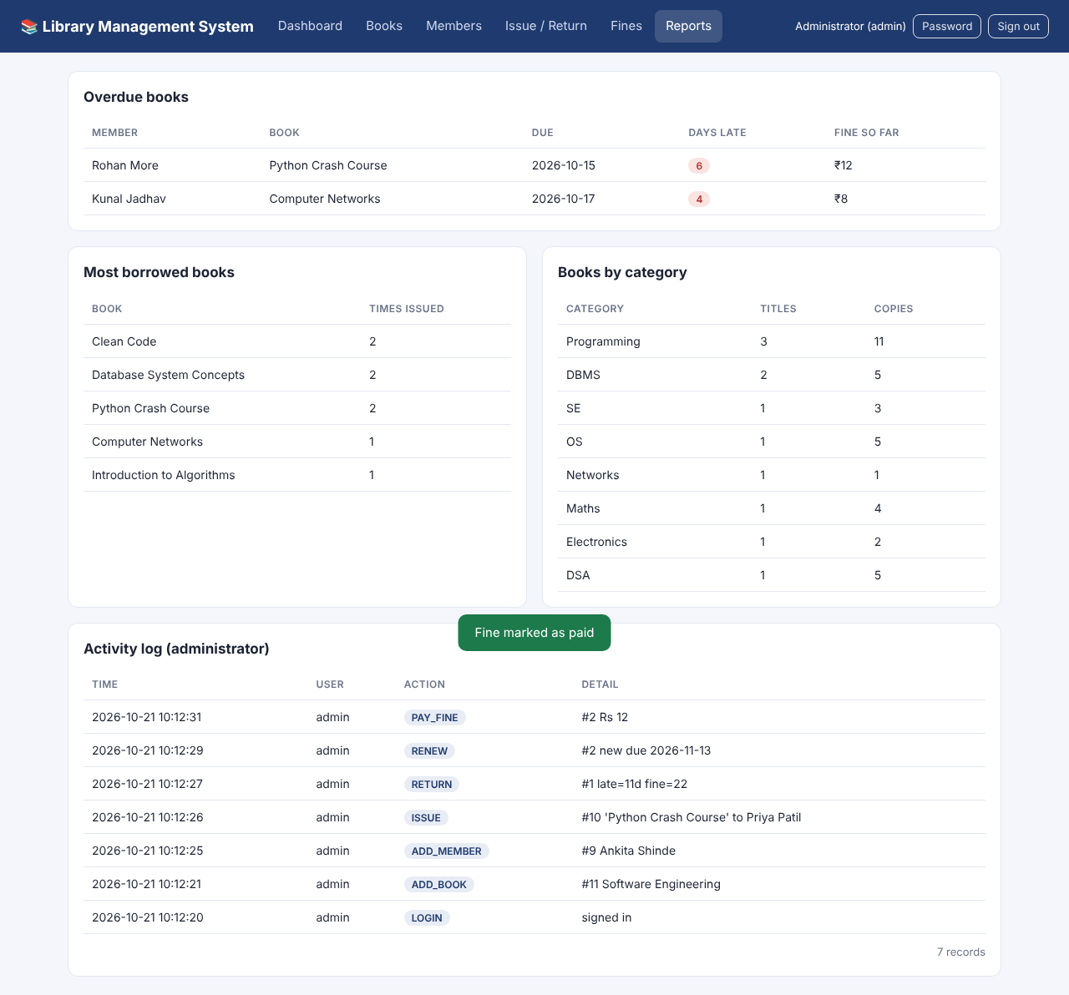
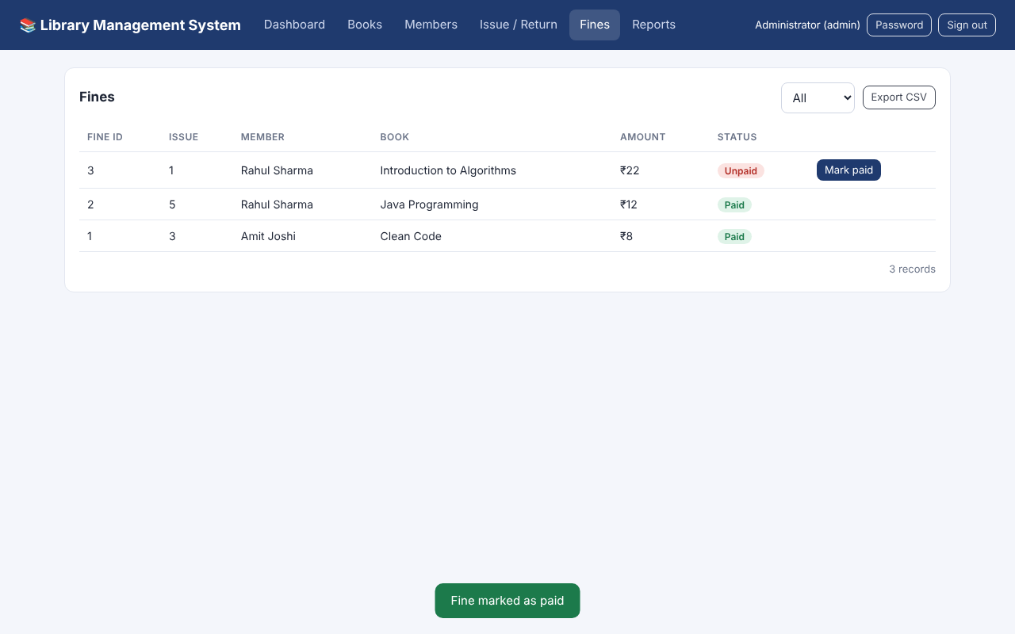
Results – Fines & Reports
Fines
Reports & activity log

Slide 16
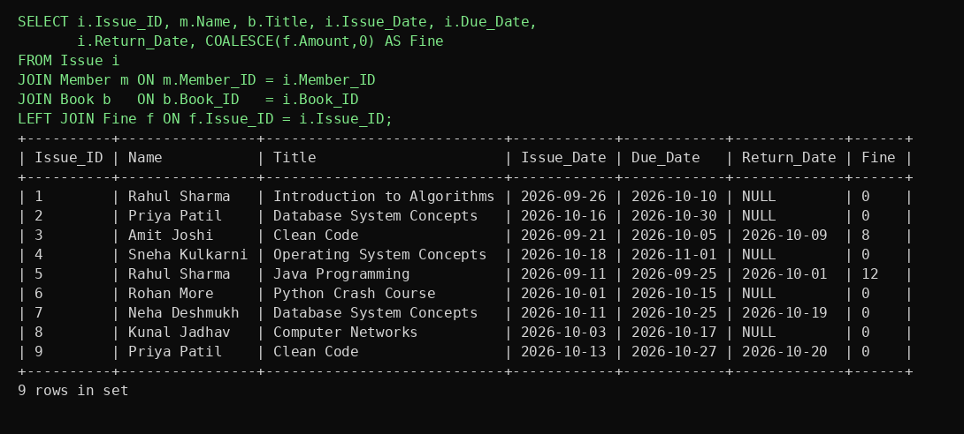
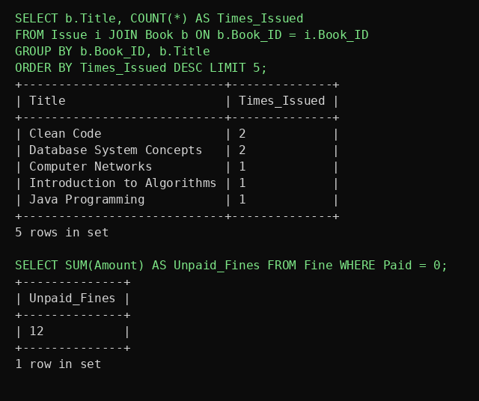
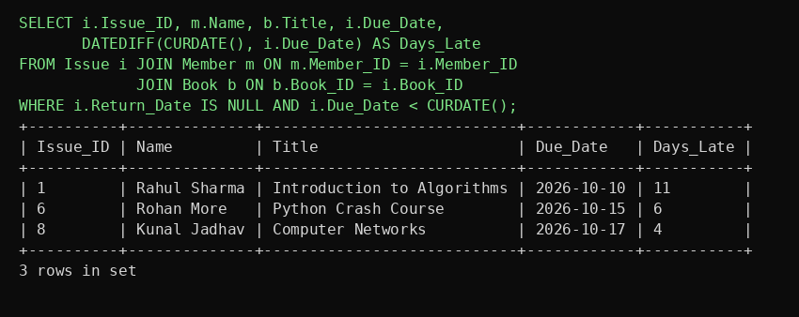
Results – SQL Queries
JOIN of Issue, Member, Book and Fine
Overdue books
GROUP BY / SUM

Slide 17
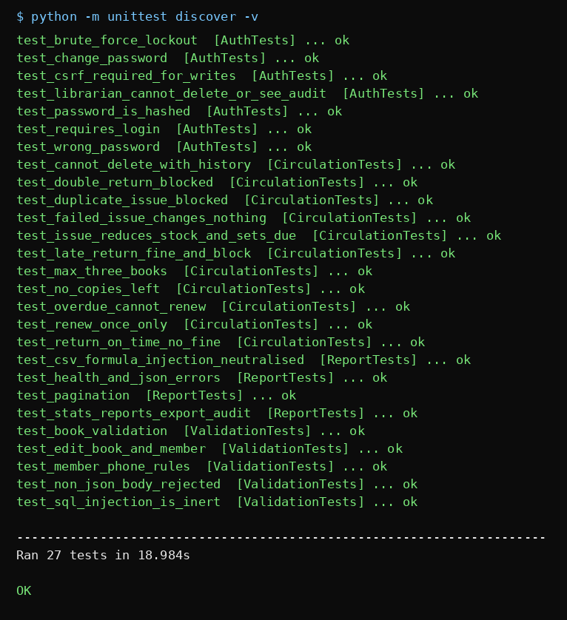
Results – Automated Tests
Tests cover:
• Login, roles, lock-out, CSRF
• Issue / return / renew rules
• Fine calculation and rollback
• Validation and SQL-injection input
• Pagination, CSV export, audit log
Result: 27 / 27 passed ✔
27 tests passed

Slide 18
Conclusion
Conclusion
The Library Management System turns DBMS concepts into a dependable web application using MySQL, Flask and a browser front end.
Key Outcomes
6 related tables with keys, constraints, view, procedure, trigger
Secure login, roles and a full activity log
Transactions keep stock, issues and fines consistent
27 tests, backups, Docker and GitHub-ready
Future Scope
Student login and online reservation
Email/SMS reminders, barcode scanning
MongoDB for catalogue metadata; mobile app

Slide 19
References
References
MySQL Documentation
Flask & PyMySQL Documentation
OWASP Cheat Sheet Series
Docker & GitHub Actions Documentation
W3Schools — SQL
GeeksforGeeks — DBMS & SQL
DBMS Course Materials

Slide 20
THANK YOU !!

